Slide 1
DevSecOps
Primary Instructor: CW2 Sean Herbert
Alternate Instructor: CW3 Nick Chadwick Instructor: CW2 Sean Herbert
Alternate Instructor: CW3 Nick Chadwick

Slide 2
Instructor Background
How you got started in DevSecOps.
What are you currently doing now.

Slide 3
Why Learn This?
75th Innovation Command is receiving an increased demand to support these kinds of missions.
Significant salary increases – 25% or more.
Anyone who works with software can incorporate DevOps.

Slide 4
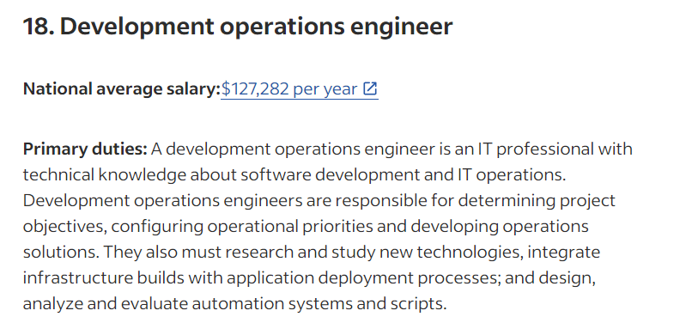
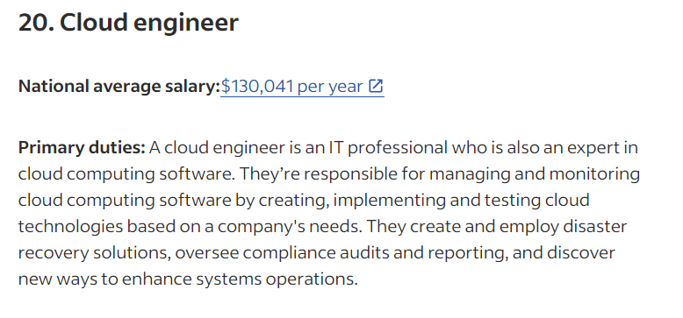
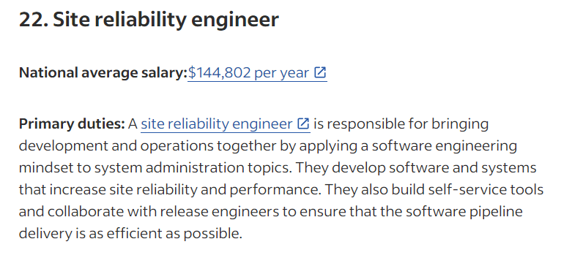
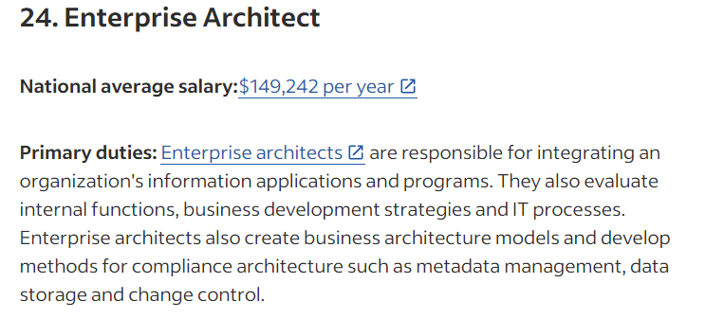
Why become a DevOps Engineer?
https://www.indeed.com/career-advice/finding-a-job/top-paying-technology-jobs

Slide 5
What is DevSecOps?
“DevSecOps is a software engineering culture and practice that aims at unifying software development (Dev), security (Sec), and operations (Ops). DevSecOps emphasizes collaboration and communication between development, security, and operations teams to deliver secure and resilient software at the speed of relevance. It involves automating security and testing processes, integrating security tools and practices into the development pipeline, and fostering a culture of shared responsibility for performance and security.” https://www.cloud.mil/devsecops/

Slide 6
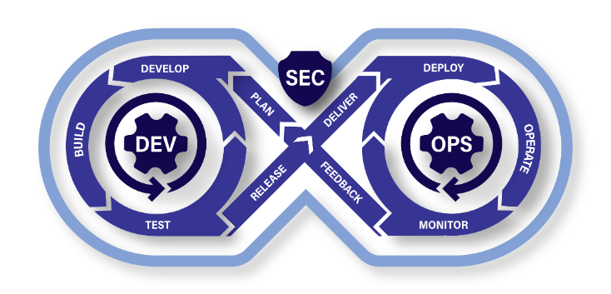

Slide 7
Key Tools that Enables DevSecOps
Infrastructure as Code (IaC)
“Infrastructure as code (IaC) is the ability to provision and support your computing infrastructure using code instead of manual processes and settings.” https://aws.amazon.com/what-is/iac/
Containerization
“Containerization is a software deployment process that bundles an application’s code with all the files and libraries it needs to run on any infrastructure.” https://aws.amazon.com/what-is/containerization/
Continuous Integration/ Continuous Deployment (CI/CD)
“CI/CD falls under DevOps (the joining of development and operations teams) and combines the practices of continuous integration and continuous delivery. CI/CD automates much or all of the manual human intervention traditionally needed to get new code from a commit into production, encompassing the build, test (including integration tests, unit tests, and regression tests), and deploy phases, as well as infrastructure provisioning.” https://about.gitlab.com/topics/ci-cd/

Slide 8
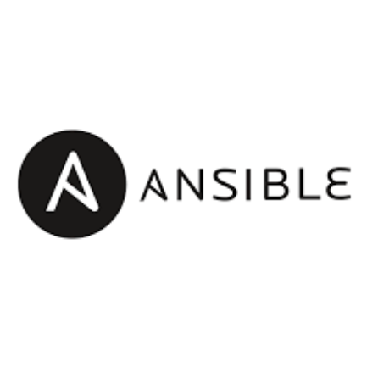

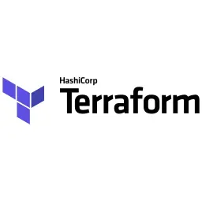
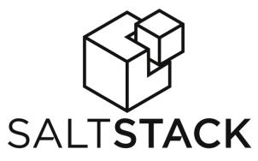
Popular IaC Tools (Persistent and Non-Persistent)

Slide 9
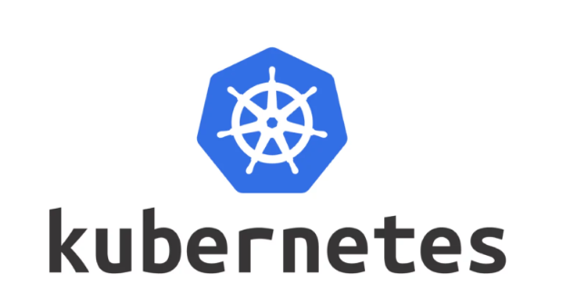
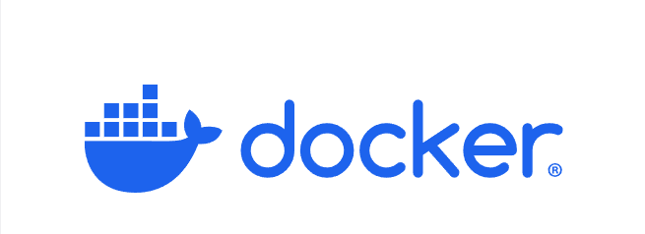
Popular Containerization Tools

Slide 10

Popular Service Mesh Tool

Slide 11

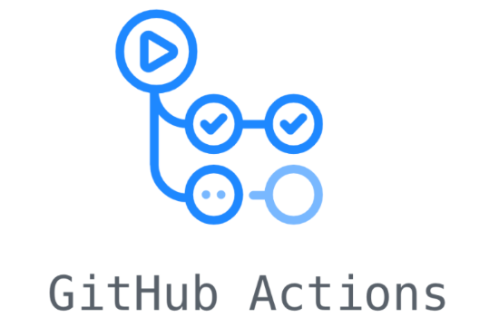
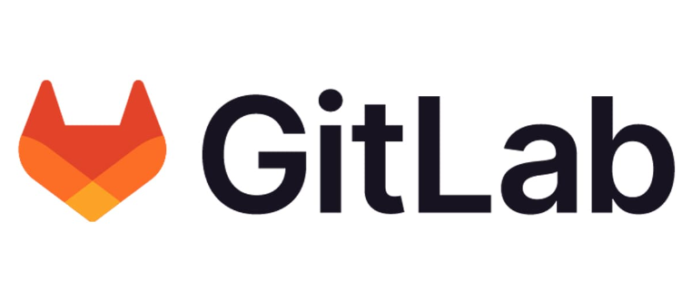
Popular CI/CD Tools

Slide 12
Common Security Vulnerability Tests
Secrets Scanning
Static Analysis Software Test (SAST)
Dynamic Analysis Software Test (DAST)
Container Software Bill of Material (SBOMs)

Slide 13
What is DevSecOps trying to enable?
DevSecOps Platform
Software Factory
Continuous Authority to Operate (cATO)

Slide 14
DevSecOps Platform
A DevSecOps platform is defined as a group of resources and capabilities that form a base upon which other capabilities or services are built and operated within the same technical framework.

Slide 15
Software Factory
A software factory is a collection of people, tools, and processes that enables teams to continuously deliver value by deploying software to meet the needs of a specific community of end users. It leverages automation to replace manual processes.

Slide 16
Continuous Authority to Operate (cATO)
cATO is the state achieved when the organization that develops, secures, and operates a system has demonstrated sufficient maturity in their ability to maintain a resilient cybersecurity posture that traditional risk assessments and authorizations become redundant.

Slide 17
Overall Benefit

Slide 18
More Resources
Department of Defense DevSecOps Guidelines
https://dodcio.defense.gov/Portals/0/Documents/Library/DoD%20Enterprise%20DevSecOps%20Fundamentals%20v2.5.pdf
Learning DevSecOps (Lectures and Hands on Learning)
https://kodekloud.com/
https://engineer.kodekloud.com/

